Slide 1
Docker 201
Andy Tauber, Staff TAM
Dave Mazur, Staff TAM
February, 2021

Slide 2
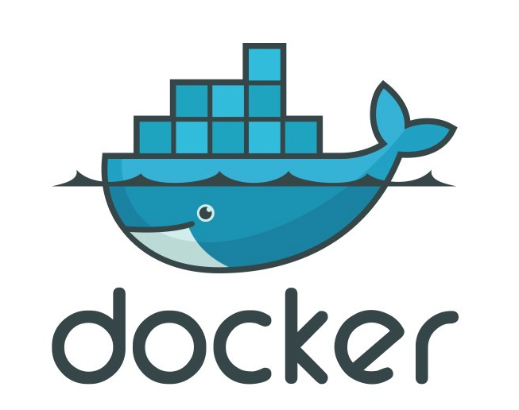
Previously in the last session…
- Micro-service architecture
Intro to Containers
Intro to Docker
Lab

Slide 3
Images
Images from Scratch
Images vs Containers
Dockerfile vs Docker Compose
Docker vs Kubernetes

Slide 4

Presentation and Playbook
Go grab a copy of the presentation and playbook to follow along
The playbook contains steps and commands we will be using
https://github.com/davemazur/tambootcamp-docker
https://gitlab.eng.vmware.com/atauber/tam-modern-apps

Slide 5
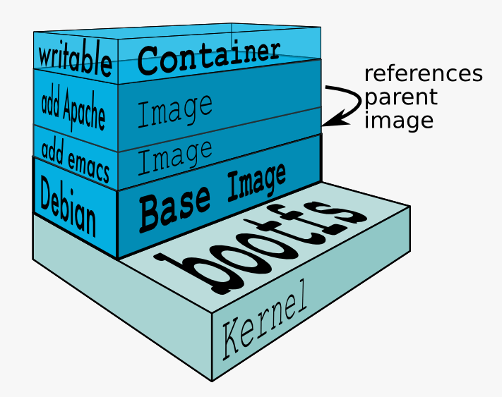
Images
Base Image
Layered Image
In the simplest form an image is a base filesystem
An image does not have a state
An image is a read-only template
Cannot be modified
You can build your own image or use images developed by others
Images are stored in a repository
Images can be based on multiple layers
Stacked on top of each other
Cannot run an image by itself
Notes:
Containers are fundamentally composed of several underlying kernel primitives: namespaces (who you are allowed to talk to), cgroups (the amount of resources you are allowed to use), and LSMs (Linux Security Modules—what you are allowed to do).
Together, these kernel primitives allow us to set up secure, isolated, and metered execution environments for our processes.

Slide 6
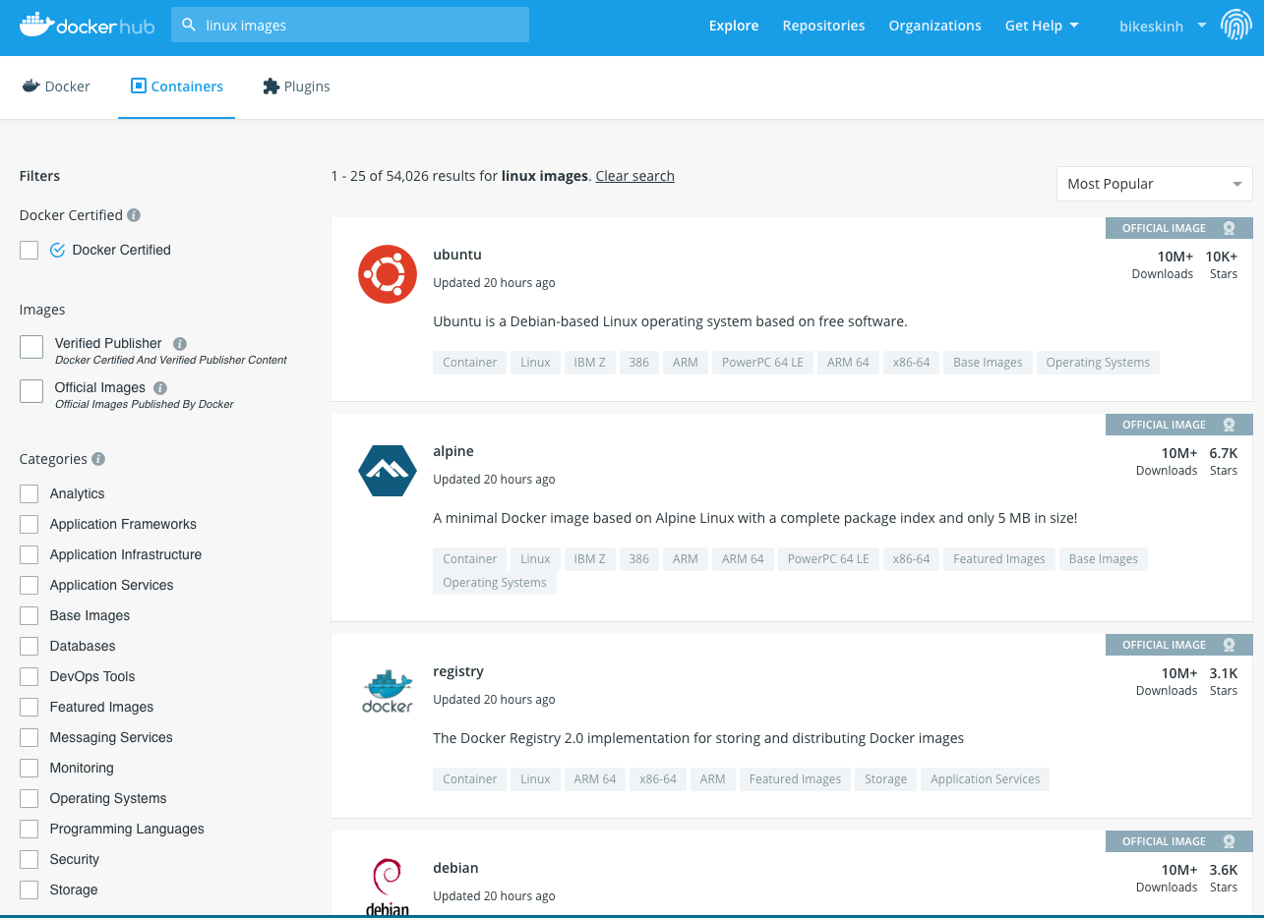
Examples of Base Images
From Docker Hub, GCR, ACR, Harbor, etc
Scratch – empty image
Alpine, BusyBox – simple linux images
Debian, Ubuntu, CentOS – more advanced linux images
Microsoft/servercore – windows server base image
Microsoft/nanocore – smaller footprint windows image

Slide 7
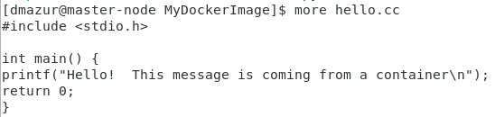
Example of building a basic image
% docker build –t hello .
% docker run hello
Dockerfile
FROM alpine:latest
COPY hello /
#this is the cmd running the application
CMD [“/hello”]
“hello” Image
Hello App from laptop
Alpine Linux

Slide 8
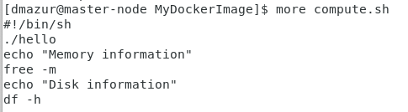
Example adding a shell script to the hello image
% docker build –t hello .
% docker run hello
Dockerfile
FROM alpine:latest
COPY hello /
COPY compute.sh /
RUN chmod +x /compute.sh
#this is the cmd running the application
CMD [“/compute.sh”]
“hello” Image
Compute.sh from laptop
Hello App from laptop
Alpine Linux

Slide 9
Example building an image from “scratch”
% docker build –t hello .
% docker run hello
Dockerfile
FROM golang:1.15-alpine AS build
WORKDIR /src/
COPY main.go go.* /src/
RUN CGO_ENABLED=0 go build –o /bin/demo
FROM scratch
COPY –from=build /bin/demo /bin/demo
ENTRYPOINT [“/bin/demo”]
“hello” Image
Demo app
Secondary Scratch image
Demo app compiled in Alpine Linux
Alpine Linux with Go Installed
Notes:
“scratch” is not a parent image. It tells docker that the image is not built on top of any other image (i.e. it is built from scratch). The ADD command adds the hello-world executable to the root directory of the image file . The CMD will run the executable (hello-world) when the container is created.

Slide 10
Finally, Images vs Containers
Hello Image
% docker build –t hello .
- Creates a read-only template
- Can be based on multiple images/layers
- Cannot run by itself
Hello Container
% docker run hello
- runnable instance of an image
- creates a writeable layer
- adds compute, network, storage
“hello” Image
Hello Image
Demo app
Docker Runtime
Secondary Scratch image
Demo app compiled in Alpine Linux
Compute
Network
Storage
Alpine Linux with Go Installed

Slide 11
A note on CPU and Memory utilization
Docker can be greedy…
Docker containers have full access to memory and cpu of the host
If you don’t limit cpu and memory, docker can use all the system resources
How to limit:
% docker run –memory=“1g” hello
% docker run –cpus=“1.0” hello
Show before and after:
% free –m
% df -h

Slide 12
Docker Volumes
Persistent Storage for Containers
Containers have a writeable layer
However, any data you write goes away when the container exits (including logs)
Solution: Create a volume on the host filesystem
% docker volume create my-vol
% docker volume ls
% docker volume rm my-vol
https://docs.docker.com/storage/

Slide 13
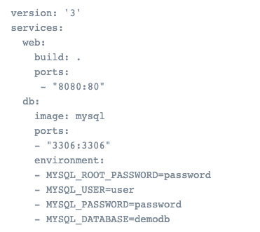
Dockerfile vs Docker Compose
Dockerfile
Simple text file
Contains commands to assemble an image
Docker Compose
YAML file (docker-compose.yml)
Defines and runs multi-container applications
Can call a Dockerfile or define everything in Compose
Configure, create and start all application services
https://docs.docker.com/compose/

Slide 14
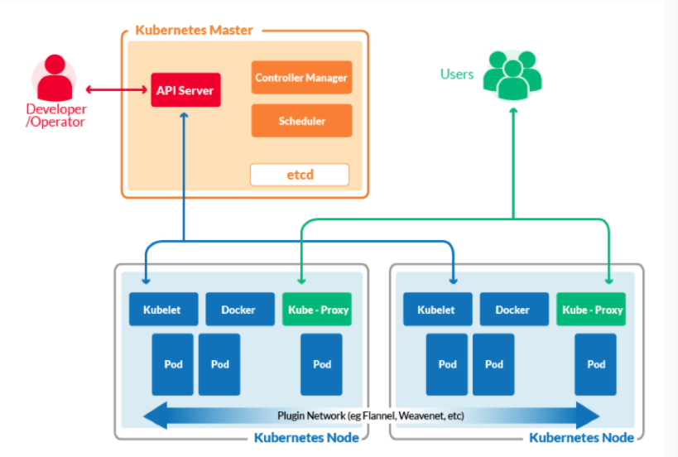
Docker vs Kubernetes
30 Second Intro to Kubernetes
Docker
Is an environment for running containerized applications on a single node
Kubernetes
Allows you to run containers across multiple compute nodes (VM or physical)
Allows you to automate container provisioning, networking, load-balancing, security and scaling across multiple nodes running Docker (or other container runtime)
Collection of nodes managed by a single Kubernetes instance is a Kubernetes Cluster

Slide 15
Next Time: Kubernetes

